Slide 1
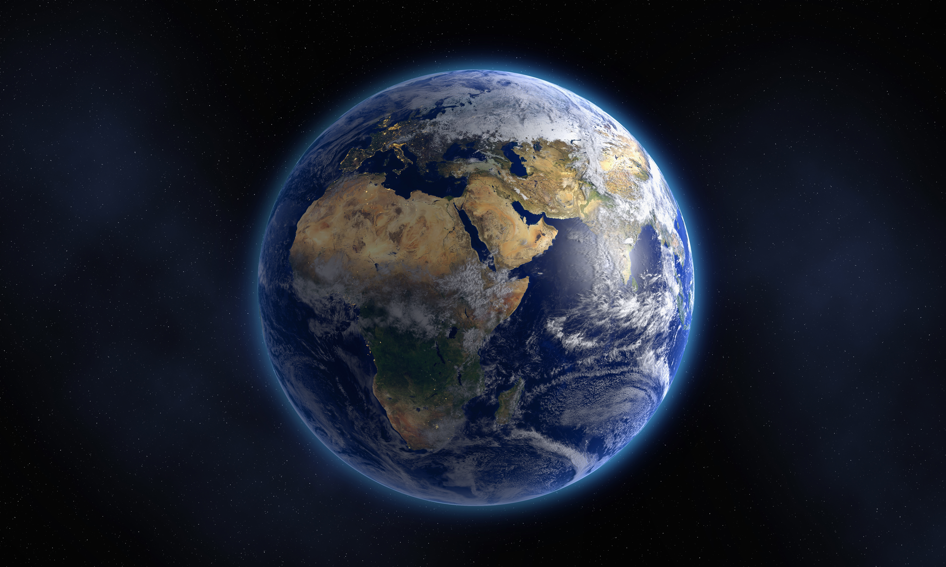
Hutton’s Quest: Rock, paper, Trivia
Wednesday, September 30th, 2020 from 5:30 to 7:30 PM CST
Hosted by:
The AAPG Women’s Network, Young Professionals SIG and STEMulating SIG
Sponsored by:

Slide 2
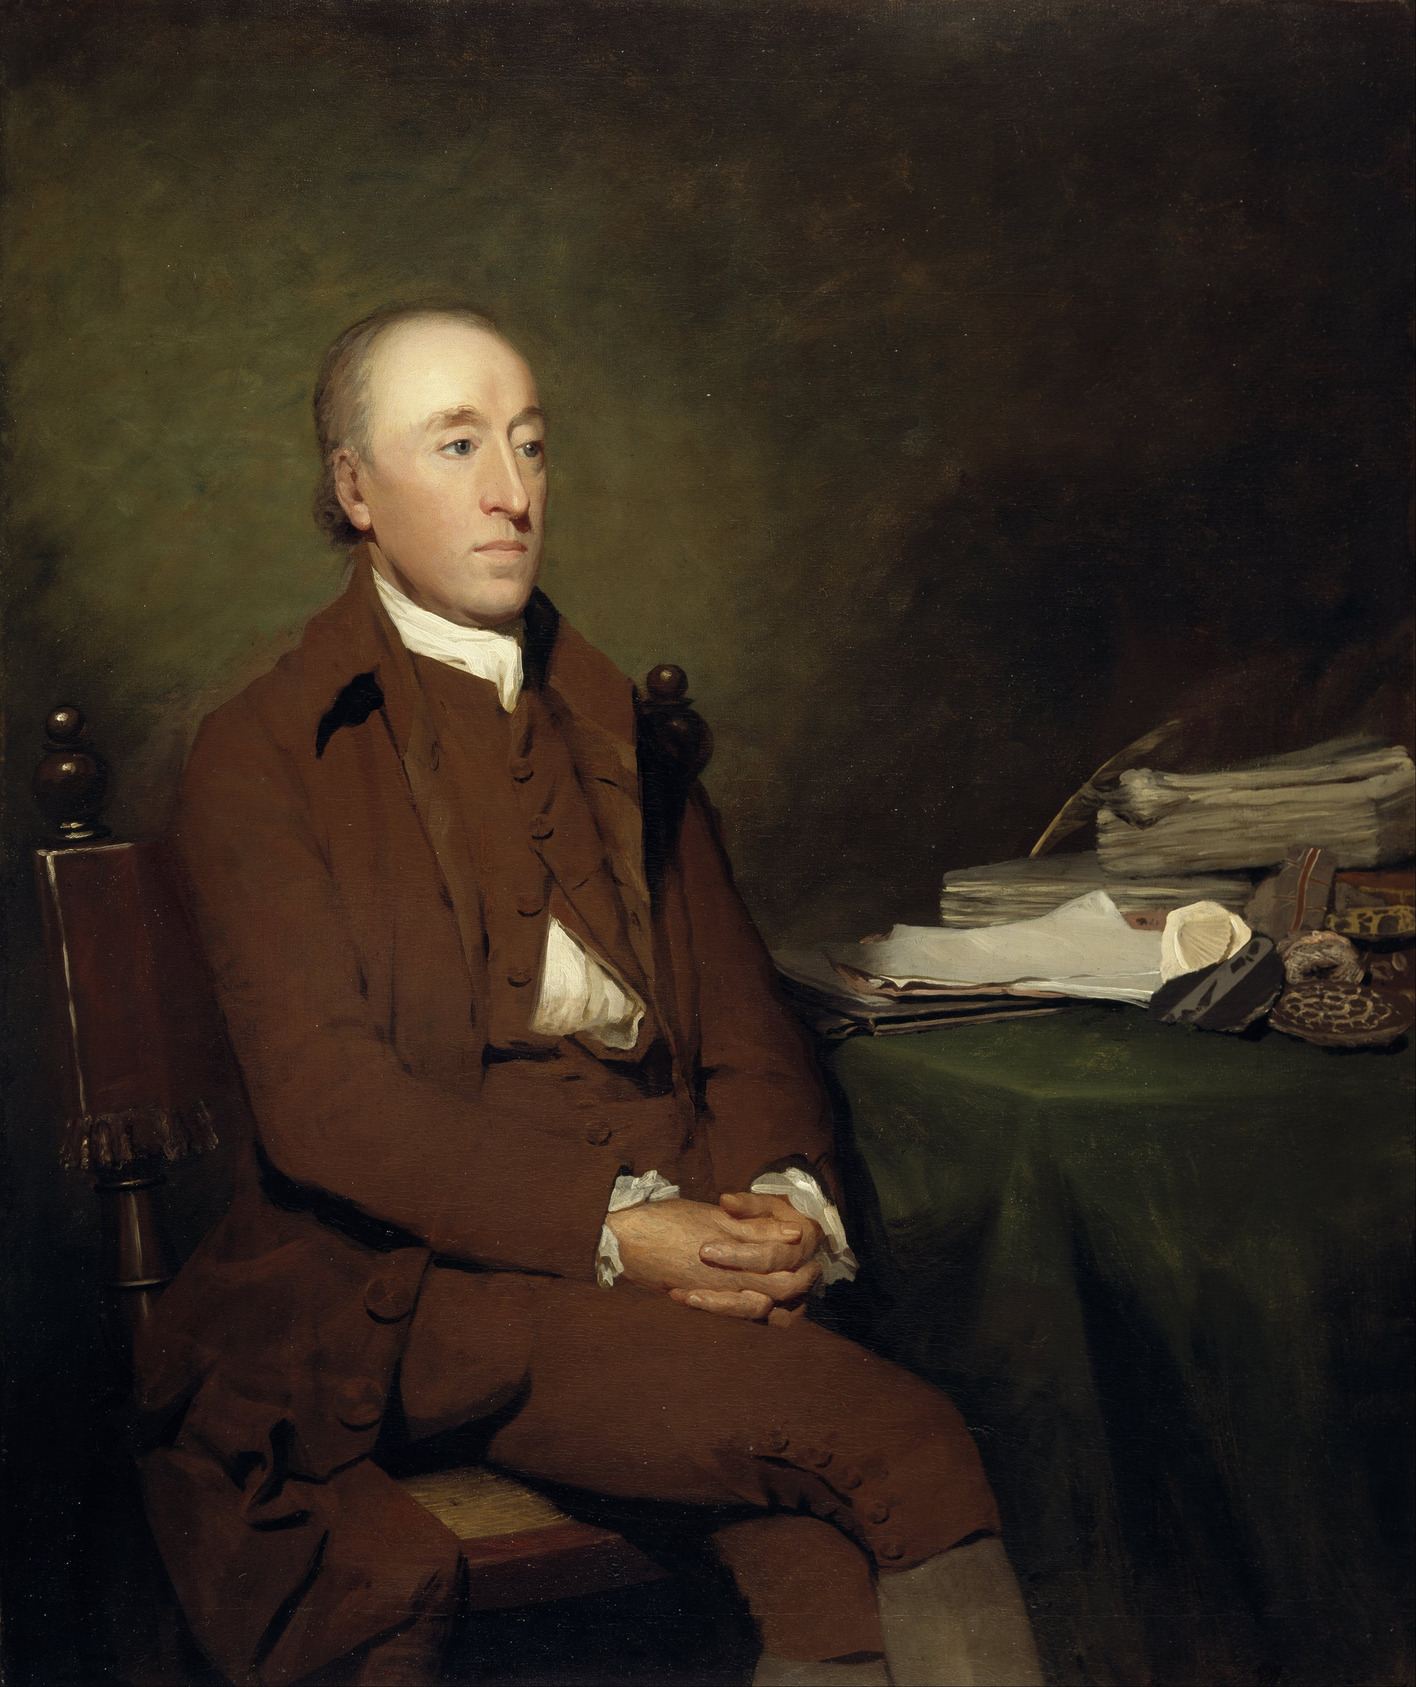
Join us on Zoom!
I’m James Hutton and I have a quest for you.
Click the Zoom link provided by AAPG in the Experience module a few minutes before the game is scheduled to begin.
You may be placed in a waiting room before being allowed to join the Zoom call.
When you join the Zoom call, your audio will be muted. You can choose to have your video on or off.
The game will be shared though Zoom so keep this window open.
You can use the chat function to talk to the hosts and other players!
If you encounter audio trouble during the game, try exiting out of Zoom and logging back in.

Slide 3
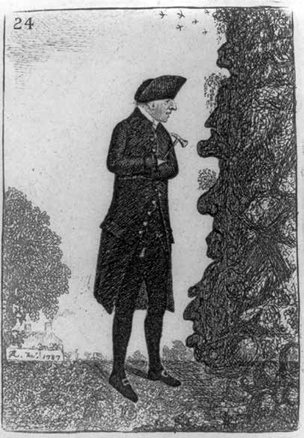
Play on kahoot!
The rocks speak to me.
Navigate to kahoot.it on your smartphone or web-enabled device. You can play on the same computer you’re using for the Zoom call, but you’ll have to flip between the Zoom call and kahoot.it. You can also download the kahoot app from your device’s app store.
Enter the kahoot Game Pin presented during the Zoom call and press Enter.
Enter your username. No pseudonyms please! We’ll need your real name if you want to win a prize!
Get ready to game! Don’t let your phone go to sleep during the game! You’ll lose valuable question-answering time.
If you discover that your kahoot isn’t advancing to the next question, try refreshing the page. You may encounter some lag depending on your internet connection.

Slide 4
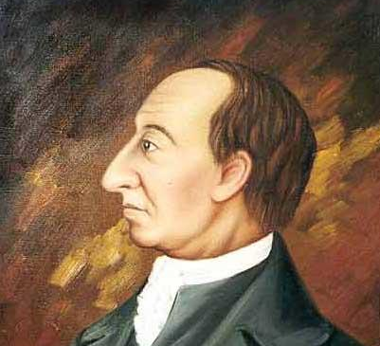
Kahoot scoring
THE MATH
Points in Kahoot are awarded according to accuracy and speed!
Divide response time by the question timer. For example, a player responded 2 seconds after a 30-second question timer started. 2 divided by 30 is 0.0667.
Divide that value by 2. For example, 0.0667 divided by 2 is 0.0333.
Subtract that value from 1. For example, 1 minus 0.0333 is 0.9667.
Multiply points possible by that value. For example, 1000 points possible multiplied by 0.9667 is 966.7.
Round to the nearest whole number. For example, 966.7 is 967 points.

Slide 5
Prizes
Grand prizes will be awarded to the top finishers at the end of the game. Smaller prizes will be awarded to the scoreboard’s top leader following a random selection of questions throughout the game.
Be sure you use a kahoot nickname that will allow us to get in touch with you after the call in case you win a prize!

