Slide 1
Division of Environmental Geosciences

Slide 2
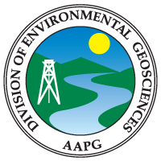
The American Association of Petroleum Geologists (AAPG) is the premier global professional organization for scientists in the petroleum industry.
The Division of Environmental Geosciences (DEG) is one of its four divisions.

Slide 3
Division of Environmental Geosciences
Our Mission:
EDUCATE the membership of AAPG and the general public about important issues that affect petroleum energy minerals exploration and production.
COMMUNICATE to the general public and government agencies the Association's commitment to protect the environment while developing the world's natural resources in a responsible manner.
SUPPORT and encourage research into the effects of petroleum/energy minerals exploration and production on the environment, and make available to concerned agencies, companies, and individuals the results of these studies and recommendations.
APPLY the expertise developed in the petroleum/energy minerals industries and hydrogeology to resolve environmental problems.
PROMOTE environmental self-regulation within the petroleum/energy minerals industries.
ESTABLISH a liaison between and among AAPG and other professional societies for the purposes of constructive dialogue and defining mutually obtainable goals.
PROVIDE relevant educational opportunities and services for professional development of the AAPG membership through seminars and conferences in environmental geosciences, hydrogeology, and related fields.

Slide 4
Division of Environmental Geosciences
DEG membership includes:
~730 Active Members
~220 Associate Members
~1,100 Student Members
DEG is administered under the AAPG Executive Committee and utilizes a President/Vice-President/Secretary/Treasurer form of governance with Executive and Advisory Committees.

Slide 5
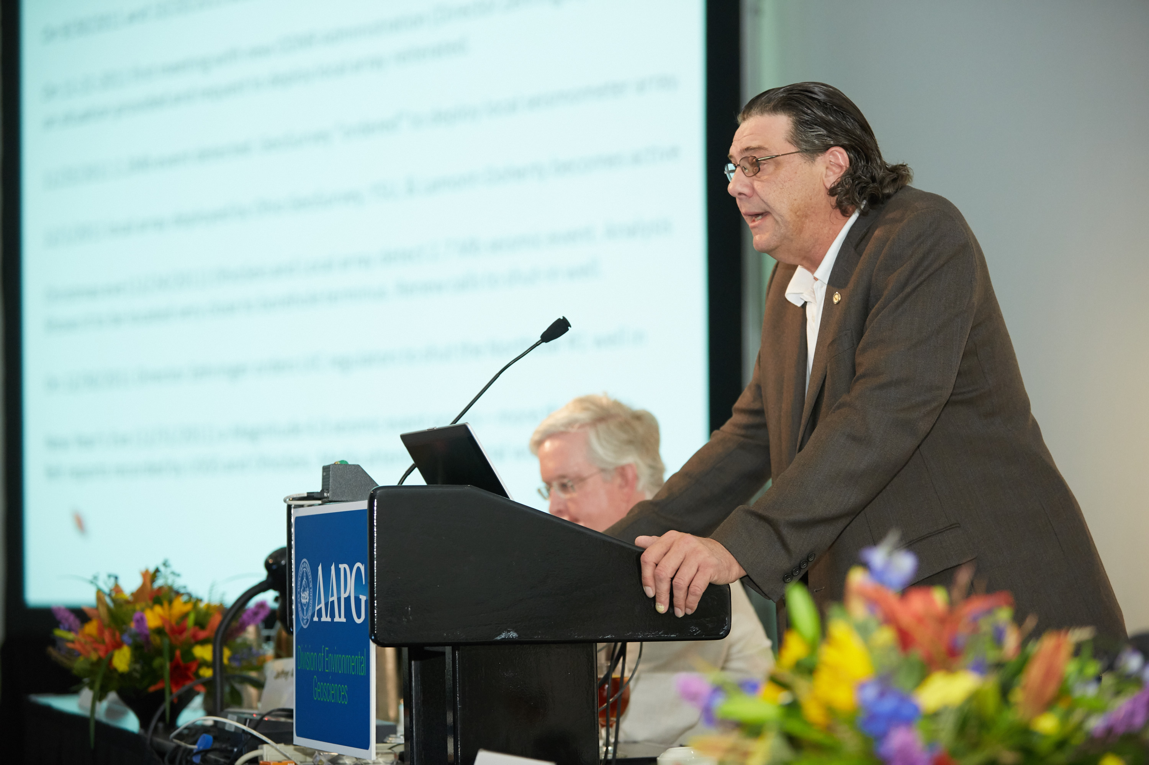
Division of Environmental Geosciences
The DEG promotes the presentation of scientific oral and poster papers during the AAPG Annual Convention and Exhibition, the AAPG International Conference and Exhibition, and at AAPG annual section meetings.

Slide 6
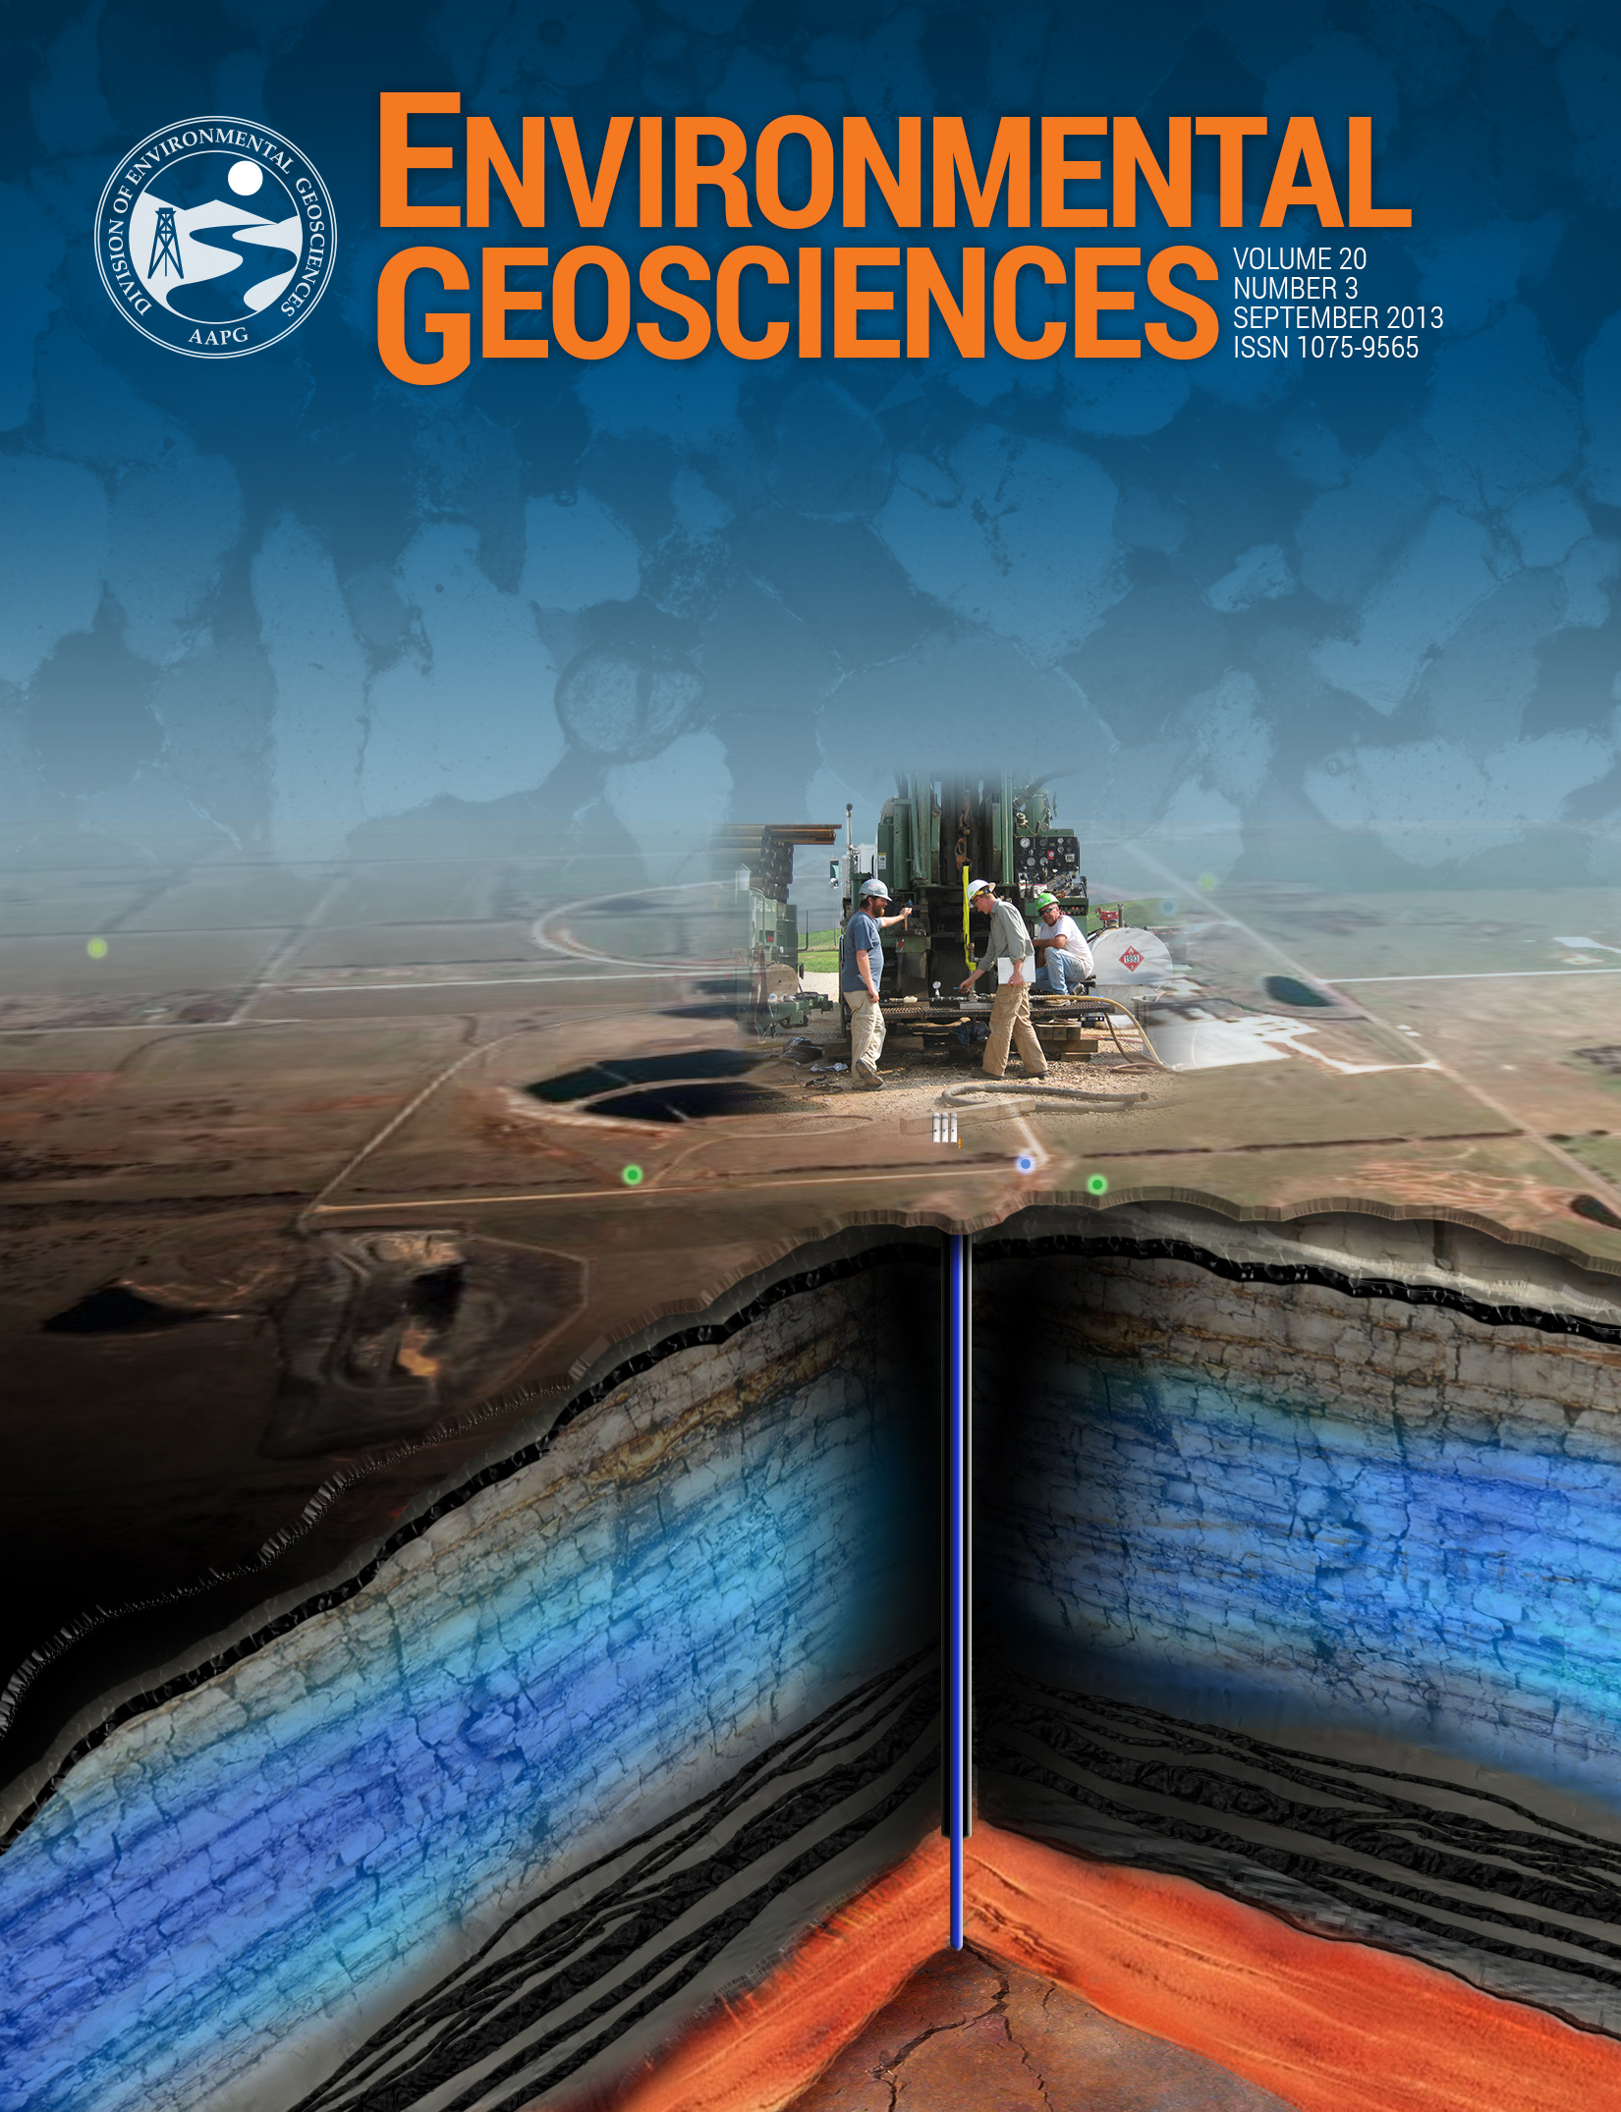
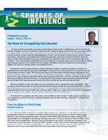
Division of Environmental Geosciences
The DEG produces two primary publications:
The Bulletin of Environmental Geosciences is a quarterly peer-reviewed journal that includes scientific papers relevant to environmental issues in the oil and gas industry. It is financially supported by advertisement revenue and has been in publication since 1994.
Spheres of Influence addresses current events in oil and gas environmental issues, promotes the mission of the AAPG and DEG, engages members, and communicates across the AAPG divisions. It is DEG’s quarterly newsletter begun in July 2011.

Slide 7
Division of Environmental Geosciences
Types of manuscripts submitted for DEG’s journal:

Slide 8
Division of Environmental Geosciences
DEG’s editing team includes:
Editor-in-Chief
Managing Editor
Special Issues Editor
Associate Editors (30): representing countries and continents around the globe including USA, Latin America, Canada, Europe, Africa, Middle East, Asia-Pacific

