Slide 1
Division of Environmental Geosciences
House of Delegates Meeting, ACE 2018
May, 2018
Stephen M. Testa
DEG President

Slide 2
Division of Environmental Geosciences
Officers
President
Vice President: Mark Lovell
President-Elect: Mary Barrett
Secretary-Treasurer: Skyler Smith
Editor: Michele Cooney
Past-President Timothy Murin
Advisory Board
(12 Members)
Represent each Section and Region and two at-large

Slide 3
Division of Environmental Geosciences
MISSION STATEMENT AND PURPOSE
EDUCATE the membership and general public
COMMUNICATE with and engage the general public and government agencies
SUPPORT research and apply expertise
PROMOTE environmental self-regulation
ESTABLISH mutually obtainable goals with other professional societies
PROVIDE educational opportunities and services for professional development of the membership

Slide 4
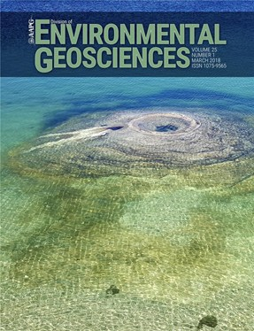
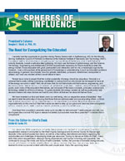
Division of Environmental Geosciences
The DEG Publications
Environmental Geosciences: a quarterly peer-reviewed digital journal of scientific papers relevant to environmental issues in the oil and gas industry. It is financially supported by advertisement revenue and has been in publication since 1994.
Michele Cooney, Editor
Spheres of Influence: addresses current events of oil and gas environmental issues, promotes the mission of the AAPG and DEG, and communicates across the AAPG divisions. It is DEG’s quarterly newsletter that began in July, 2011.
Barbara Kutchko, Managing Editor

Slide 5
Division of Environmental Geosciences
DEG Current Focus and Activities
Restructured Technical Committees to support DEG’s newsletter and journal
Environmental Geophysics
Water Resources
Carbon Capture, Utilization and Storage (CCUS)
Induced Seismicity
Fugitive Gases and Emissions
Emphasized DEG’s visibility at Section meetings, ACE and ICE
with strong and varied environmental program
Provide young professionals and students a venue for publishing their work in environmental geoscience with DEG
Develop a strong technical publication program in environmental geoscience germane to the energy sector

Slide 6
Division of Environmental Geosciences
865 Total Members (as of 05/16/2018)
Full Members 603
Associate Members 161
Honorary 27
Student Young Professional Members 20
Student Members 40

Slide 7
Division of Environmental Geosciences

Slide 8
Division of Environmental Geosciences
America First Energy Plan (Jan. 11, 2018)
Energy Independence
Energy Exported
Environmental Stewardship
Other Relevant Topics
Data Integrity
Sustainability
Environmental Stewardship
“Lastly, our need for energy must go hand-in-hand with responsible stewardship of the environment. Protecting clean air and clean water, conserving our natural habitats, and preserving our natural reserves and resources will remain a high priority.”

Slide 9
Division of Environmental Geosciences
We are all Environmental Stewards
Environmental Stewardship
Permitting and land use
Regulatory compliance
Tort law litigation
Water management
Water quality
Underground injection
Aquifer exemptions
Induced seismicity
CO2 capture, storage and utilization
Well integrity
Well abandonment
Fugitive emissions
Soil and groundwater contamination
Climate change
Oil spills and gas leaks
Public outreach
Environmental studies (i.e., NEPA)
Based on word count alone from the
America First Energy Plan we should be at 15%

Slide 10
Division of Environmental Geosciences
In closing – Why DEG:
If you think environmental issues and concerns are not part of the oil and gas business, maybe you should think again.
If you think you are not an environmental steward, maybe you should reconsider.
If you are not a member of DEG, maybe you should be.

